Slide 1
PowerShell Advanced Fundamentals

Slide 2
Introduction

Slide 3
Introduction
Björn Sundling
bjorn.sundling@advania.com
https://bsky.app/profile/bjompen.com
You?
Get-Participant
Get-Expectation

Slide 4
Introduction
Agenda
git Started
VS Code
Filters, Functions and Advanced Functions
PowerShell Classes
Regex Intro
API
Error Handling
Debugging
Building Modules
Testing with Pester

Slide 5
Introduction
Bring Your Own Lab!
It’s easier to understand your own issues

Slide 6
Introduction
How to do labs?
Lab.md –No solutions.
Detailed.md – Some help.
More than one way of solving an issue.
“If it’s stupid and it works, it’s not stupid”

Slide 7
Introduction
Lab 0
https://github.com/AdvaniaSE/PowerShellAdvancedFundamentals
00. Install PowerShell & VSCode

Slide 8
Try Along!
Try stuff
Break stuff
Fix stuff
Understand stuff

Slide 9
git Started

Slide 10
git Started
Why version control?
Script-Folder problem
v1
v2
v2.final
Central location for main data
Where's latest?
Snapshot based - Go back and forth in time
History of What, When and Whom
Collaboration

Slide 11
git Started
git vs GitHub
Git is a protocol
GitHub is a Service
(with many many alternatives!)

Slide 12
git Started
Your service provider – GitHub/Azure DevOps/BitBucket et. al.
Fork
Pull request / PR
CLI
GitHub CLI
az devops

Slide 13
git Started
Only six commands!
git status
Show current git changes
git init / git clone
Create an empty repo or clone an existing “remote”
HTTPS vs. SSH?
git add
Add one or more files for staging
git pull
Find and download “remote” changes
git commit
Create a snapshot
-m ‘message’
Add a commit message without entering vim…
git push
Push changes to remote

Slide 14
git Started
Working with branches
Strategies
GitHub Flow
Git Flow
Trunk based development / single branch
Git checkout –b
Create a branch and change to it directly
Git branch
Create a branch but stay on current one

Slide 15
git Started
Visual tools
Start with CLI
VS Code
GitHub Desktop
posh-git / OhMyPosh

Slide 16
git Started
Lab 1
https://github.com/AdvaniaSE/PowerShellAdvancedFundamentals
01. git Started
https://i.redd.it/8341g68g1v7y.png - Git cheat sheet

Slide 17
VSCode

Slide 18
VS Code
Why?
Free
Cross-platform
Open source
Microsoft standard

Slide 19
VS Code
Basic Features
Open Folder
ISE mode (for the old school PowerShell devs)
Snippets
git integration
Extensions
From PowerShell...
...via HTML previews....
..to live share!

Slide 20
VS Code
Editor Features
Move row
Comment
Multi Cursor
Multi select
Bracket pair colorization

Slide 21
VS Code
PowerShell Integration
Terminal
IntelliSense
Code-format
Debugger

Slide 22
VS Code
F1 – The key to the kingdom.

Slide 23
Filters, Functions and Advanced Functions

Slide 24
Filters, Functions and Advanced Functions
Goal: Re-Use Code!
Multiple copies are hard to maintain
Never Copy & Paste code!
Hiding details makes a script easier to read

Slide 25
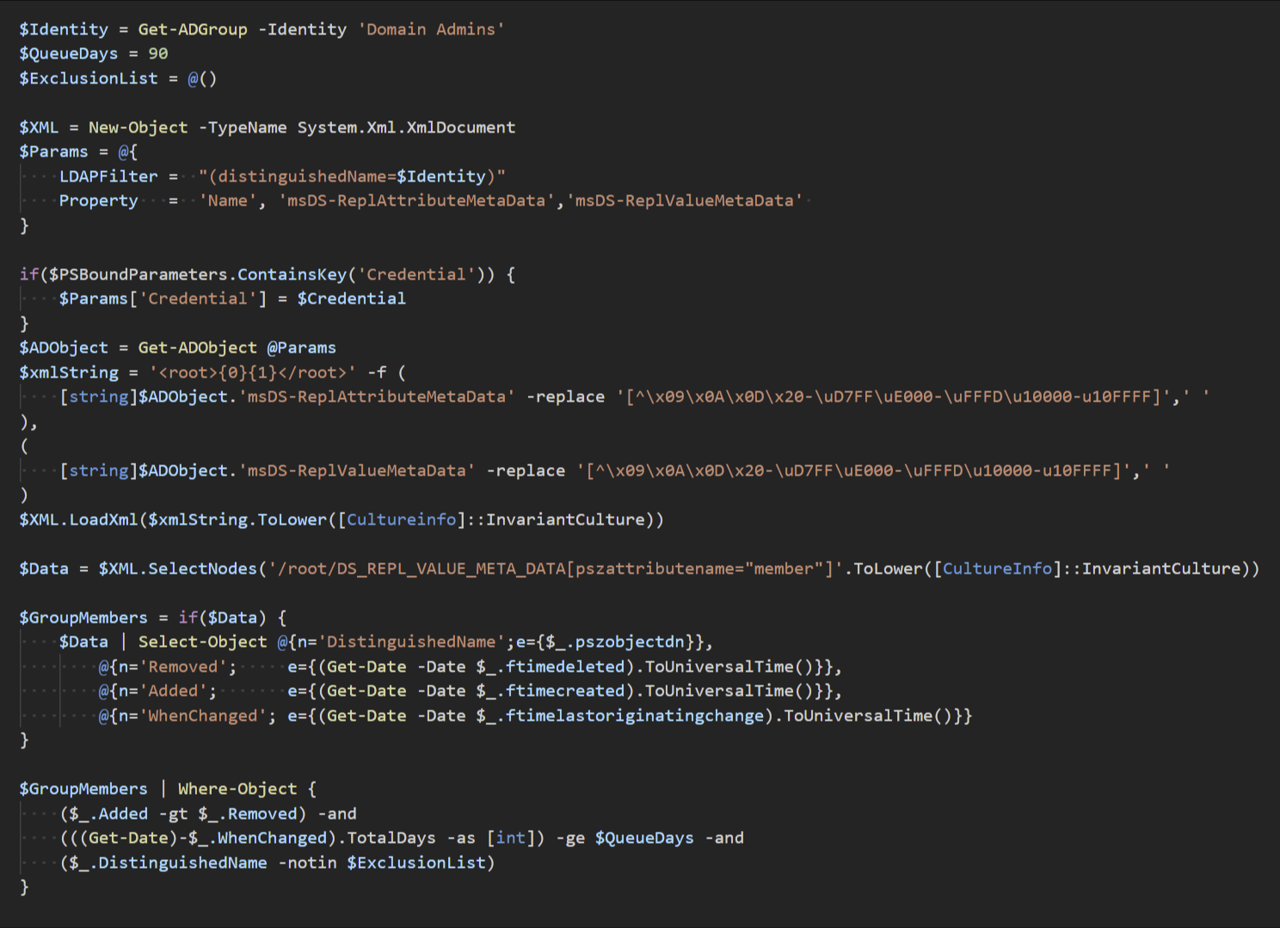
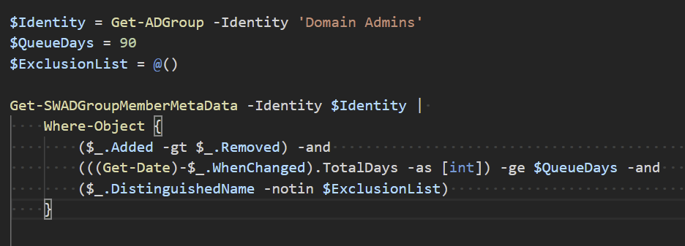
Filters, Functions and Advanced Functions
Example
Just code
Function and code

Slide 26
Filters, Functions and Advanced Functions
Verb-Noun
Get-Verb
(Better in PS7!)
Unless you are writing “internal” functions.

Slide 27
Filters, Functions and Advanced Functions
Function scoped variables
$PSBoundParameters
Always available
Only contains key/value of parameters
$PSCmdlet
Only in advanced functions
Contains “everything” about a function execution
$PSCommandPath
Only in saved files
Contains full path to .ps1/.psm1

Slide 28
Filters, Functions and Advanced Functions
Three Types of "functions"
Filters
Extremely uncommon
Your own "Select" commands
Behaves like a function with all code in the ‘process’ block
Repeats once per input from pipeline

Slide 29
Filters, Functions and Advanced Functions
Three Types of "functions"
Function
Not for pipelines
Easy to understand
Good for "helpers“
Can still use parameters, named or $args

Slide 30
Filters, Functions and Advanced Functions
Three Types of "functions"
Advanced Function
CmdletBinding
ConfirmImpact
DefaultParameterSetName
HelpUri
SupportsShouldProcess
OutputType()

Slide 31
Filters, Functions and Advanced Functions
Three Types of "functions"
Advanced Function
Begin {}, Process {}, End {}
(and clean {} if you are on 7.3 or later..)
If not defined, all code is in the end {} block

Slide 32
Filters, Functions and Advanced Functions
Three Types of "functions"
Advanced Function
Rich Parameter support
Metadata
Mandatory
Position
Pipeline Input
ParameterSetName
Alias
HelpMessage
DontShow
Type
Implicit Casting
Validation
AllowNull()
AllowEmptyString()
ValidateCount(1,5)
ValidateLength(1,5)
ValidatePattern('+')
ValidateScript( { Test-Path $_ } )
ValidateSet( 'Apelsin', 'Banan', 'Clementin')
ErrorMessage

Slide 33
Filters, Functions and Advanced Functions
Three Types of "functions"
Advanced Function
Switch-Parameters
On / Off

Slide 34
Filters, Functions and Advanced Functions
Lab 2
https://github.com/AdvaniaSE/PowerShellAdvancedFundamentals
02. Functions

Slide 35
PowerShell Classes

Slide 36
PowerShell Classes
Comes from DSC – Dynamic State Configuration
More Dev-Oriented

Slide 37
PowerShell Classes
[ClassName]::New()
New-Object -TypeName

Slide 38
PowerShell Classes
Only output from return
Class
Property
Method
Constructor
Hidden Property
Static
Can also do
Inheritance
Interfaces
More….

Slide 39
PowerShell Classes
Enum
enum <name> {}
Bitflag-like
[flags()] enum <name> {}

Slide 40
PowerShell Classes
Lab 3
https://github.com/AdvaniaSE/PowerShellAdvancedFundamentals
03. Classes

Slide 41
Regex

Slide 42
Regex
Pattern matching
Validating input
Searching for part of text
Log searching w. Select-String
Phone number
Birth date
Replacing text

Slide 43
Regex
-Match
$matches variable
[regex]::Match / [regex]::Matches
Case sensitive!

Slide 44
Regex
Use web tools
But remember to check the RegEx flavors – PowerShell uses .Net
Regular Expression Language - Quick Reference
Microsoft Learn
Regex101.com
Online regex tester and debugger: PHP, PCRE, Python, Golang and JavaScript

Slide 45
Regex
Special characters
[]$.|?*+()

Slide 46
Regex
Character classes
Word
Space
Digit
Character group
Unicode

Slide 47
Regex
Quantifiers
?
*
+
{2}
{2,}
{2,5}

Slide 48
Regex
Groups
Subexpression My name is (+)
Named Subexpression My name is (?<name>+)

Slide 49
Regex
Lab 4
https://github.com/AdvaniaSE/PowerShellAdvancedFundamentals
04. Regex

Slide 50
API
(yeah, ok, web APIs…)

Slide 51
API
What is an API?
Rest and SOAP.

Slide 52
API
Invoke-WebRequest
Raw data results
Invoke-RestMethod
Parses results
Better in PowerShell 7
Entirely different backend in PS7
Behaves different. Verify your code.

Slide 53
API
Authentication
Basic
Username / password
PAT - Personal Access Tokens
OAUTH
-UseDefaultCredentials

Slide 54
API
TLS
[Net.ServicePointManager]::SecurityProtocol = [Net.SecurityProtocolType]::Tls12
Encoding
[console]::OutputEncoding = [System.Text.Encoding]::UTF8

Slide 55
API
Lab 5
https://github.com/AdvaniaSE/PowerShellAdvancedFundamentals
05. API

Slide 56
Error Handling

Slide 57
Error Handling
Two kinds of errors
Terminating
Stops the command or pipeline
Get-Item 'BadFile.bad' -ErrorAction Stop ; Write-Host 'bad file is bad'
Non-terminating
Continues the command or pipeline
Get-Item 'BadFile.bad' ; Write-Host 'bad file is bad'
(actually three – or even more - Statement terminating and script terminating)
https://stackoverflow.com/a/72802148

Slide 58
Error Handling
ErrorAction / ErrorActionPreference
ErrorView
Get-Error
(Coming soon Available in 7.5 – RecommendedAction!)

Slide 59
Error Handling
Try/Catch/Finally
Trap{}

Slide 60
Error Handling
Lab 6
https://github.com/AdvaniaSE/PowerShellAdvancedFundamentals
06. Error Handling
The art of throwing errors - Emrys MacInally - PSConfEU 2024

Slide 61
Debugging

Slide 62
Debugging
Hard see what happens inside your code
Better than “Write-Host” 😉
Can debug other and external processes

Slide 63
Debugging
VSCode Breakpoints
Line
Condition
HitCount
Log
Watch window

Slide 64
Debugging
Set-PSBreakpoint
Line
Script
Action
Column
Command
Script
Action
Variable
Script
Action
Mode

Slide 65
Debugging
Lab 7
https://github.com/AdvaniaSE/PowerShellAdvancedFundamentals
07. Debugging

Slide 66
Building Modules

Slide 67
Building Modules
Basic
psm1
Folder name
Manifest

Slide 68
Building Modules
Splitting code
Private
Public
Class

Slide 69
Building Modules
Combining code
Faster load time
Looking good

Slide 70
Building Modules
Help
Comment Based
External Help

Slide 71
Building Modules
Module helper tools
ModuleBuilder - Combine and build your modules
PlatyPS - Write help in Markdown
Invoke-Build - Build automation tool
Sampler - All of the above

Slide 72
Building Modules
Modules can be done in C# or F#
Publish to PSGallery
Possible to create your own

Slide 73
Building Modules
Lab 8
https://github.com/AdvaniaSE/PowerShellAdvancedFundamentals
08. Building Modules

Slide 74
Testing Code with Pester

Slide 75
Testing Code with Pester
Testing Code
Unit
Integration

Slide 76
Testing Code with Pester
Commands
Describe
Context
It
Should
Mock

Slide 77
Testing Code with Pester
TDD
Infrastructure Testing

Slide 78
Testing Code with Pester
Lab 9
https://github.com/AdvaniaSE/PowerShellAdvancedFundamentals
09. Pester

Slide 79
PowerShell Advanced Fundamentals
Bjorn.sundling@advania.com

